Slide 1
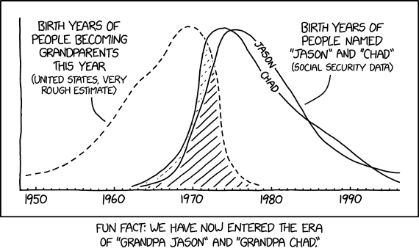
Week 11:Test review; Multivariate regression
Geog4300: Shannon

Slide 2
What tests have we covered?
T-tests: One-sample, Two-sample, Paired, non-parametric
Chi-square
ANOVA
Correlation
Regression
In pairs or on your own: Come up with a research question that can be answered by one of these tests. We will try to guess which one.
Notes:
Alternative hypothesis is usually what you’re trying to prove.

Slide 3
Multivariate regression:
Why to include more variables?
Because more than one independent variable might be relevant.
Because you want to rule out (or “control for”) other factors.
Notes:
Alternative hypothesis is usually what you’re trying to prove.

Slide 4
An example: What census variables would be associated with the per capita count of Waffle Houses in a county?
Race/Ethnicity: % classified White, Black, American Indian, Asian, Hispanic, Hawaiian/Pacific Islander, Other
Educational attainment: % Less than high school, High school graduate, Some college, BA Degree, Graduate degree
% in poverty
Nativity: Naturalized/native citizen, Foreign-born naturalized, Foreign-born/not a citizen
Think of:
What research question you would be trying to answer?
A hypothesized relationship between the variables you chose
Notes:
Alternative hypothesis is usually what you’re trying to prove.

Slide 5
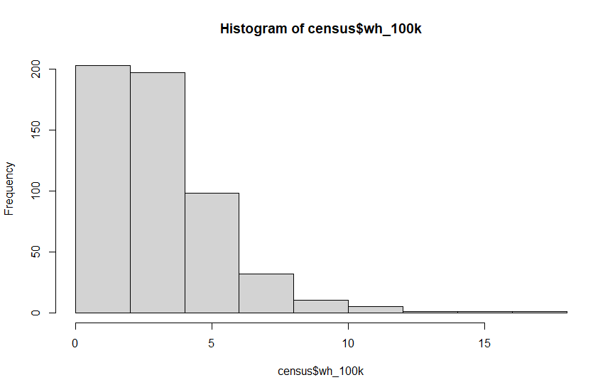
First check: Normality
Notes:
Alternative hypothesis is usually what you’re trying to prove.

Slide 6
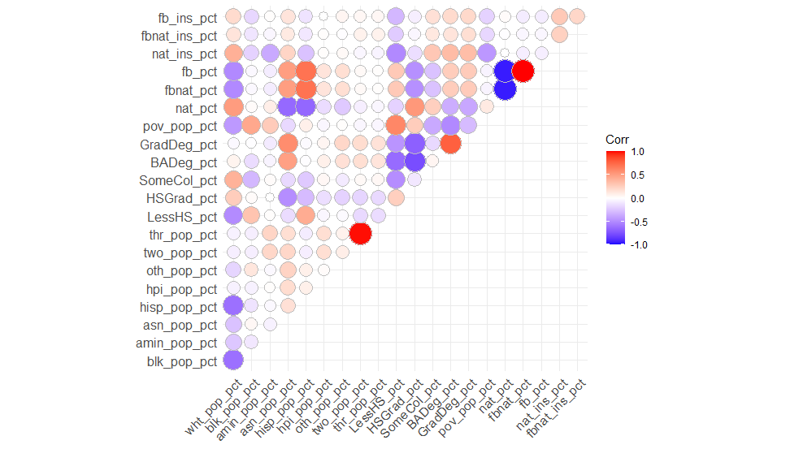
Second check: Multicollinearity
Highly correlated variables will cause confusion in the model if included together.
Notes:
Alternative hypothesis is usually what you’re trying to prove.

Slide 7
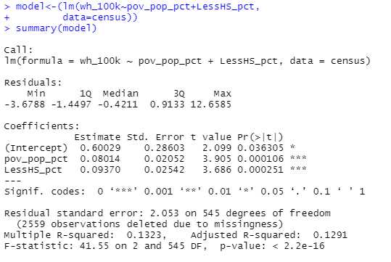
Let’s run a model!
Using only counties with Waffle Houses. How can we interpret these results?
Notes:
Alternative hypothesis is usually what you’re trying to prove.

Slide 8
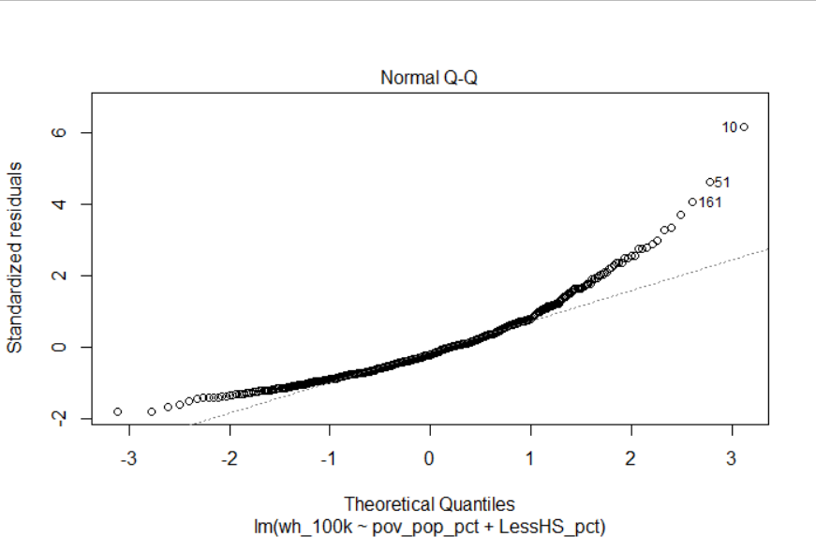
Let’s check diagnostics
Normality of residuals
Notes:
Alternative hypothesis is usually what you’re trying to prove.

Slide 9
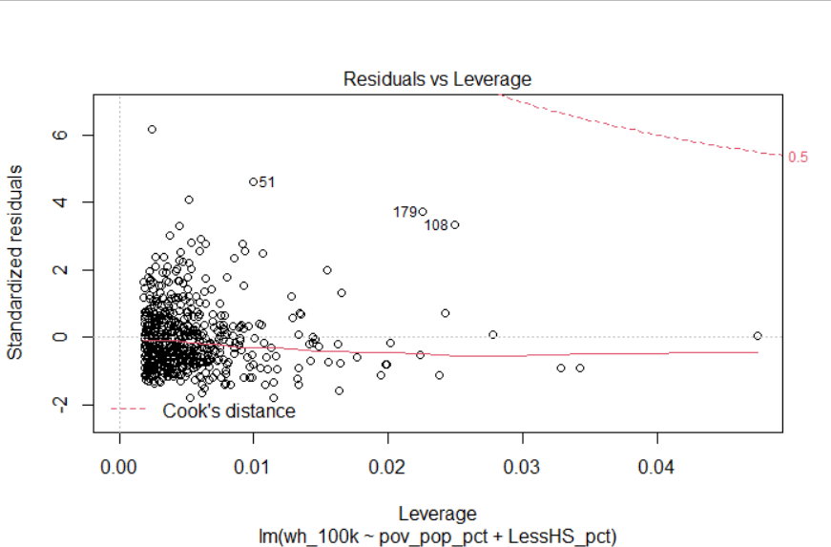
Let’s check diagnostics
Outliers: Cook’s Distance
Notes:
Alternative hypothesis is usually what you’re trying to prove.

Slide 10


Let’s check diagnostics
Multicollinearity: Variance inflation factor (VIF)
Should be around 3 or less
Example of what you DON’T want to see…
Notes:
Alternative hypothesis is usually what you’re trying to prove.

Slide 11
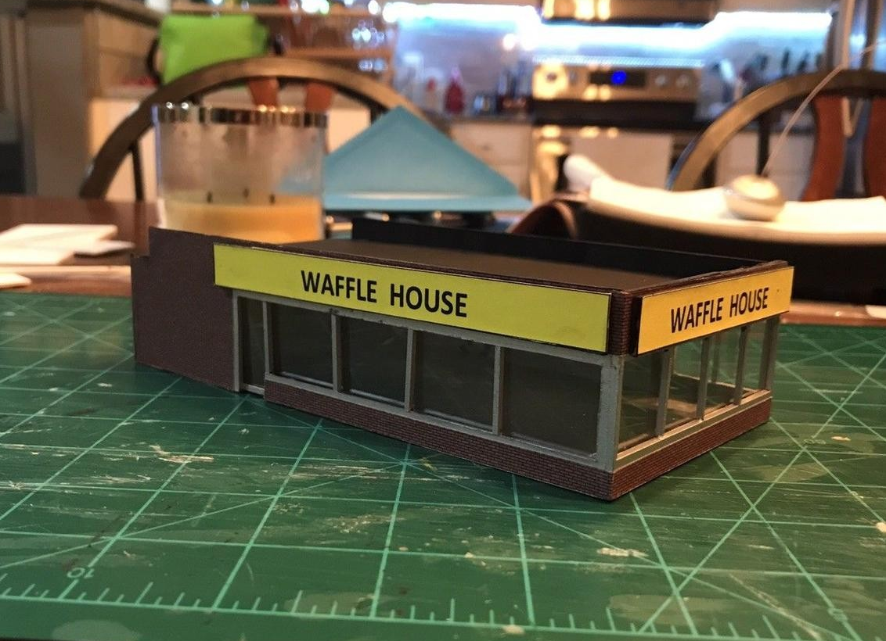
Let’s try it out: what’s the best model?
Notes:
Alternative hypothesis is usually what you’re trying to prove.

Slide 12
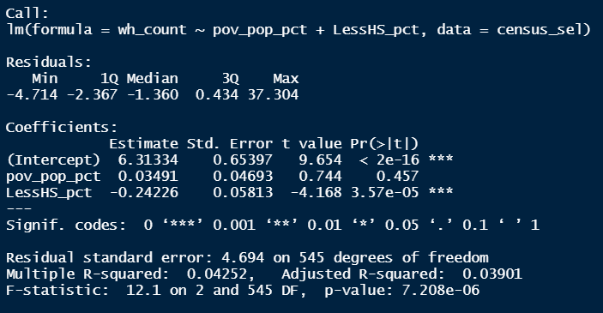
What if our model was based on store COUNT?
Notes:
Alternative hypothesis is usually what you’re trying to prove.

Slide 13
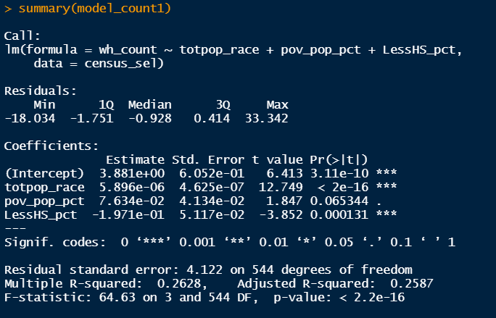
Controlling for population…
We still probably need different models…
Notes:
Alternative hypothesis is usually what you’re trying to prove.

Slide 14
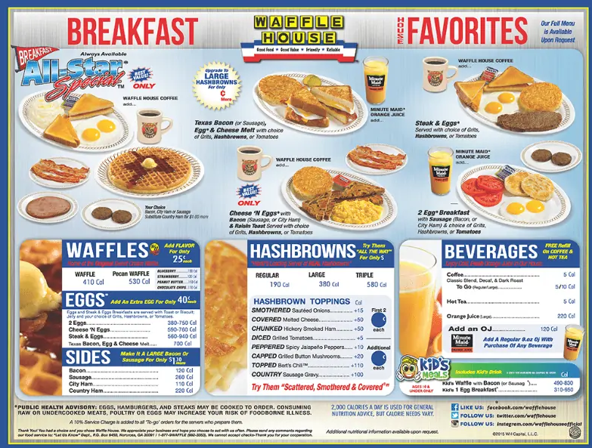
What other variables should we consider? Why?
Notes:
Alternative hypothesis is usually what you’re trying to prove.

Slide 15
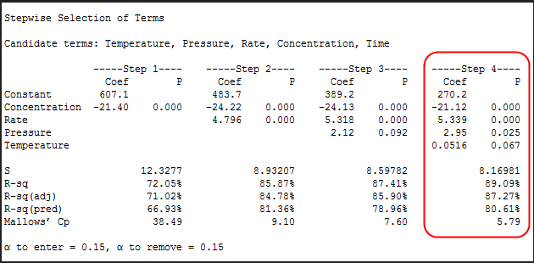
Variable selection: Stepwise regression
Notes:
Alternative hypothesis is usually what you’re trying to prove.

